Slide 1



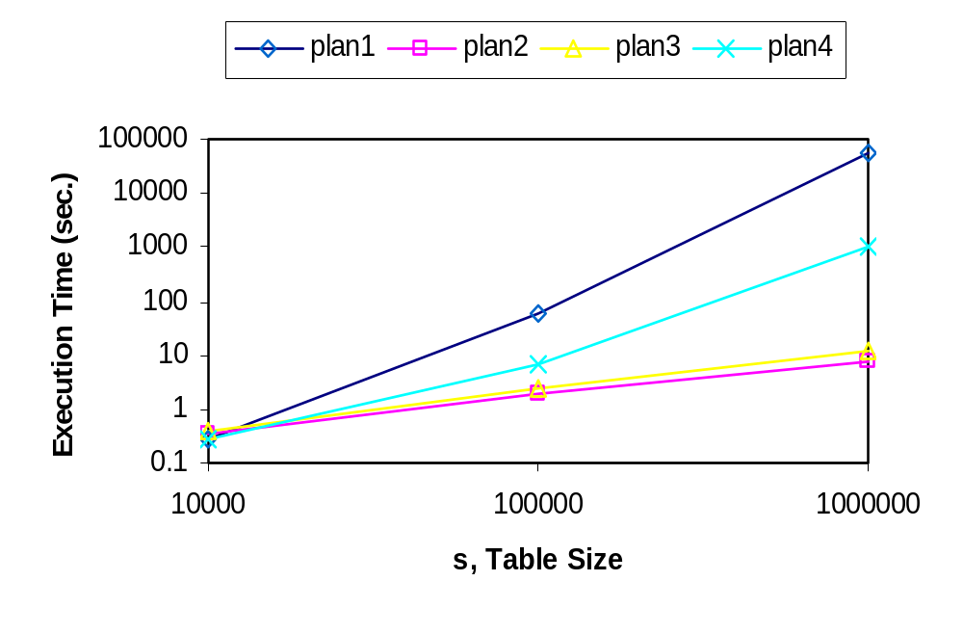
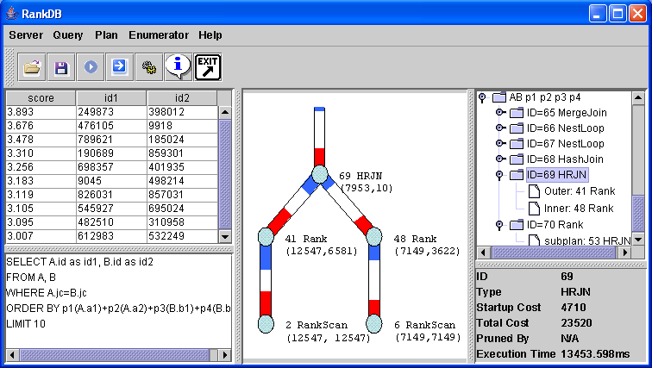
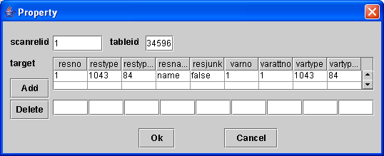
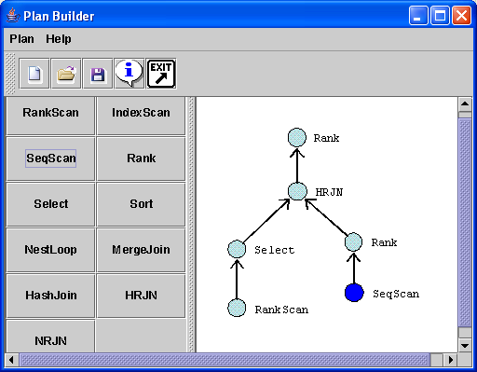






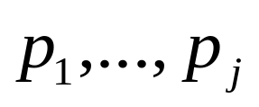
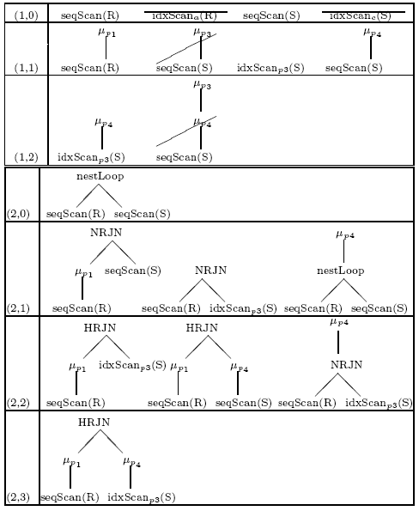
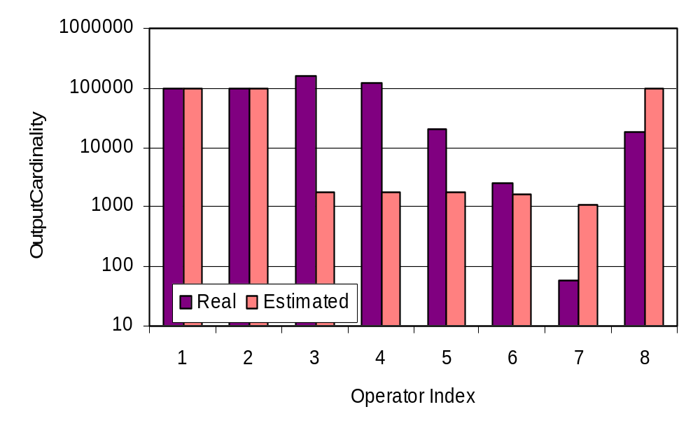

RankSQL: Supporting Ranking Queries in RDBMS
Chengkai Li, Mohamed A. Soliman, Kevin Chen-Chuan Chang, Ihab F. Ilyas
UNIVERSITY OF ILLINOIS AT URBANA-CHAMPAIGN, UNIVERSITY OF WATERLOO
The Context: AIMing to the top
The Problem: Supporting Ranking in RDBMS
The Demonstration:
The ultimate goal of the AIM project --
Supporting ranking in data retrieval
Support ranking as a first-class query type
Integrate ranking with Boolean query constructs
6
HID
MID
cheap
close
related
score
3
2
Select *
From
Hotel h, Museum m
Where
h.star=3 AND
h.area=m.area
Order By
cheap(h.price) +
close(h.addr, “O’Hare airport”) +
related(m.collection, “dinosaur”)
Limit 5
query
h1
m2
0.9
0.7
0.8
2.4
4
Query Specification
select * from [sources]
where [filtering condition]
order by [ranking function F]
h2
m1
0.6
0.8
0.9
2.3
5
h1
m3
0.9
0.7
0.6
2.2
Rank Formulation
Query Evaluation
B
membership dimension:
Boolean predicates,
Boolean function
1
Filter Formulation
Rank Evaluation
order dimension:
ranking predicates,
monotonic scoring function
ranked results
Rank Integration
(with Boolean)
R
Orders of magnitude cost difference:
plan 1: traditional plan
plan 2-4: new ranking query plans
Relational DBMS
or middleware
sources (e.g,, Web)
RankSQL front-end: (1) query; (2) enumerator visualizer; (3) execution monitor; (4) results.
Plan Builder: (5) plan editor; (6) operator property.
Our Challenges:
Our Insight: Splitting and Interleaving
Our Principle: Ranking Principle
Our Solution: RankSQL [SIGMOD’05]
RDBMS treats ranking as second class:
Monolithic ranking component R.
Processed after Boolean component B.
Naïve materialize-then-sort scheme:
Only 5 top results are requested,
whole results are scored and ordered;
Scan and join unnecessary tuples;
Ranking predicates can be expensive:
cheap(h.price): online source
related(m.collection,“dinosaur”):IR
close(h.addr,“O’Hare airport”): querying geographical data
Support ranking as a first-class query type in RDBMS:
splitting ranking predicates.
Integrate ranking with traditional Boolean query constructs:
interleaving ranking predicates with other operations.
Tuples should be processed in the order of their upper-bound scores with respect to the evaluated predicates.
Foundation: Rank-Relational Algebra
Data model: rank-relation
Operators: new and augmented
Algebraic laws
Impact: Query Engine
Executor:
  Physical operators implementation
  Incremental plans
Optimizer:
  Plan enumeration
  Cost estimation
Execution Monitor
5 results
5 results
5 results
results
plan file
Plan Executor
Query Engine
sort
sort
query tree
Y
execution plan
R
R
tuple t₁
Plan Builder
X
tuple t₂
Enumerator Visualizer
Plan
Enumerator
Cost Estimator
B
B
parsed query
Database Sampler
reduction of intermediate results, thus processing cost
R
Query Parser
query
Task 1: Algebraic Foundation
Task 2: Rank-Aware Query Optimizer
Contributions: Summary
Rank-Relational Algebra
Data Model: Rank-Relation S_{P}
S (membership); P (order) : evaluated predicates
Operators:
  Order dimension: μ (rank) operator
  Satisfying splitting requirement;
  Membership dimension: augmented rank-aware operators σ π ∩ υ −
  Satisfying interleaving requirement.
Algebraic laws: e.g., σ(μ(S_{P}))≡ μ(σ(S_{P}))
μ_{p3}
TID
upper-bound
Two-Dimensional Plan Enumeration:
Sampling-Based Cardinality Estimation:
For supporting ranking in RDBMS, we developed:
Key insight:
  Splitting and interleaving
Fundamental Principle:
  Ranking principle
Algebraic foundation:
  Rank-Relation
  New and augmented operators
  Algebraic laws
Optimization Framework:
  Two-dimensional plan enumeration
  Sampling-based cardinality estimation
s2
2.55
s1
2.4
TID
p1
p2
p3
TID
upper-bound
s1
0.7
0.8
0.9
s2
2.75
s2
0.9
0.85
0.8
μ_{p2}
s1
2.5
s3
0.5
0.45
0.75
s3
1.95
s4
0.4
0.7
0.95
TID
upper-bound
s2
2.9
Scan_{p1}(S)
s1
2.7
s3
2.5

